Slide 1
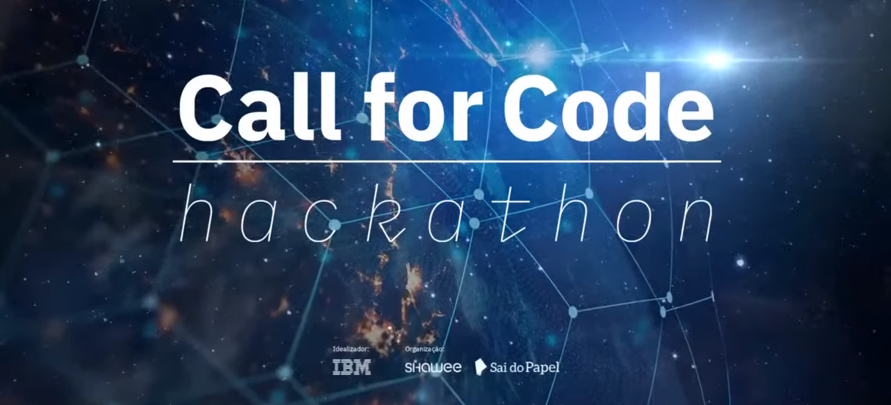
2021-07-30
Clean water and sanitation
forest4water -Nature Based Solutions (NBS) for improving water access and quality -
forest4water@gmail.com

Slide 2
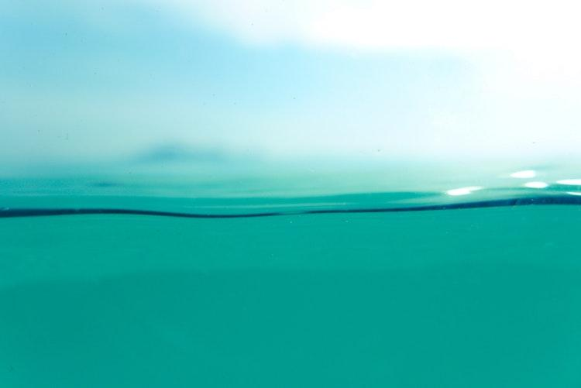
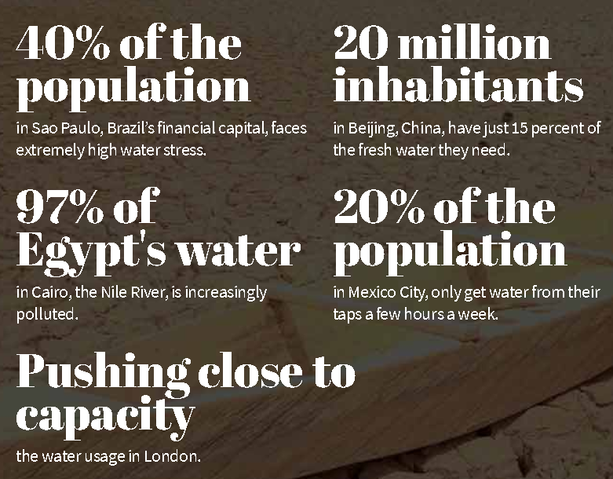
¿Where and who requires water?
gfa.org

Slide 3
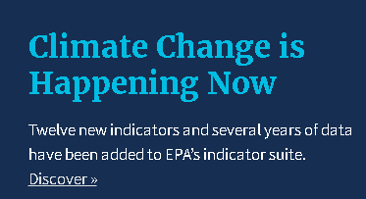
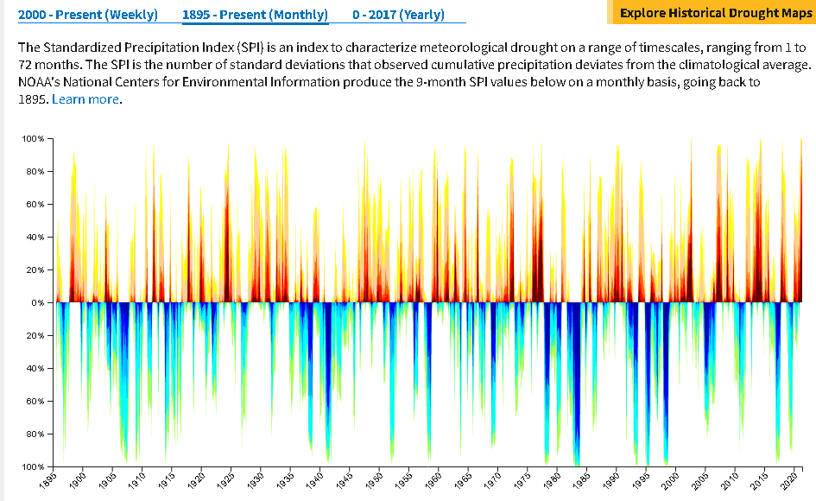
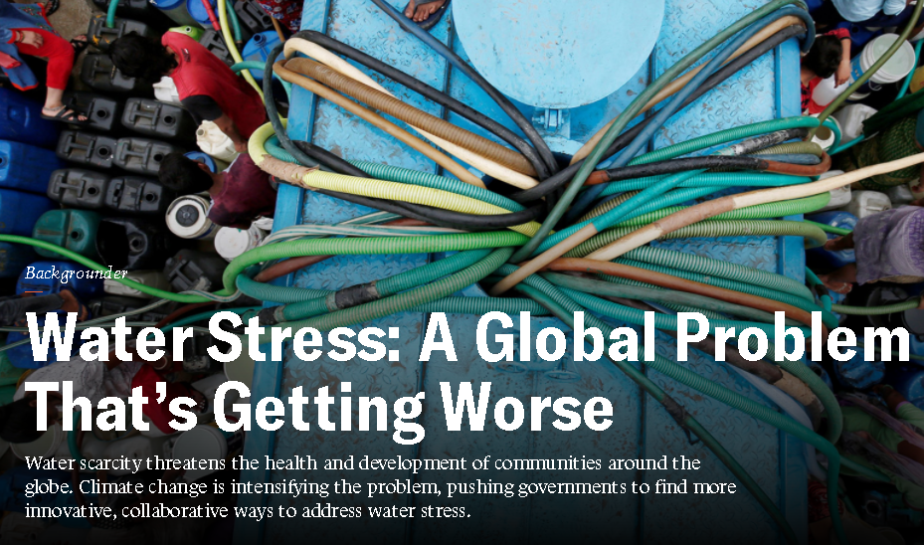
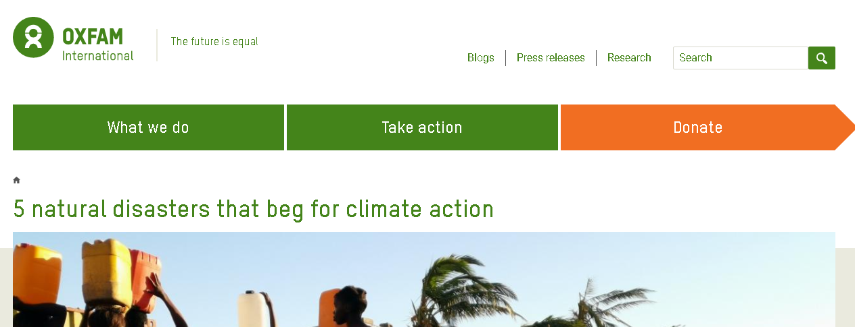
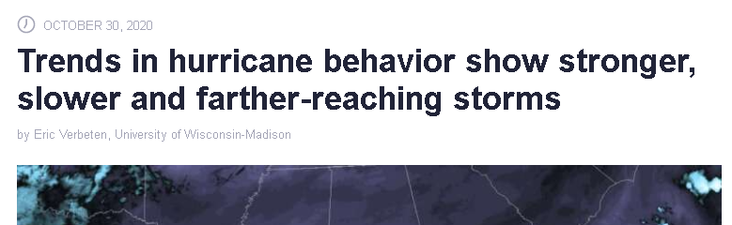
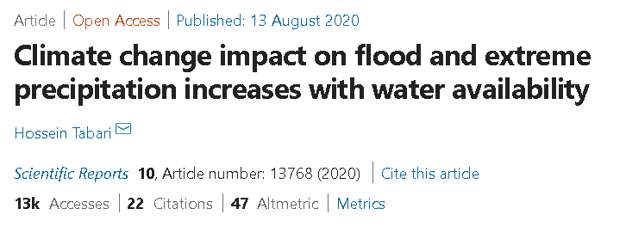
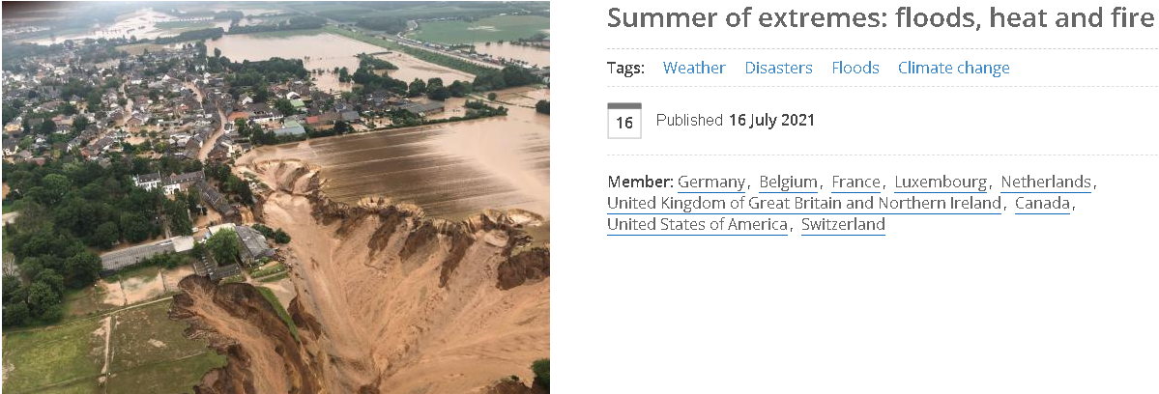
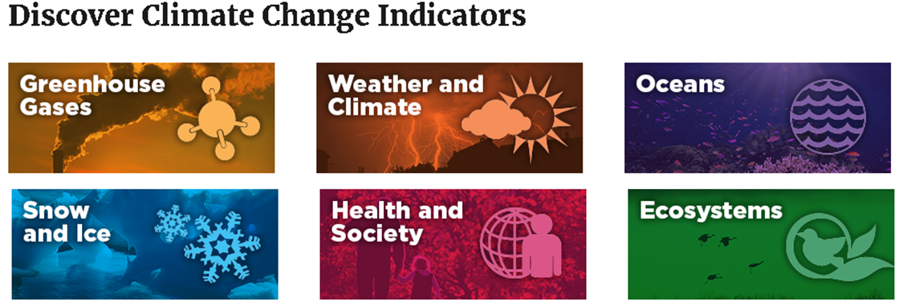
What is the problem? Climate change?
Notes:
Climate change impact on flood and extreme precipitation increases with water availability | Scientific Reports (nature.com): https://www.nature.com/articles/s41598-020-70816-2
Summer of extremes: floods, heat and fire | World Meteorological Organization (wmo.int): https://public.wmo.int/en/media/news/summer-of-extremes-floods-heat-and-fire
Water Stress: A Global Problem That’s Getting Worse | Council on Foreign Relations (cfr.org): https://www.cfr.org/backgrounder/water-stress-global-problem-thats-getting-worse
Climate Change Indicators in the United States | US EPA: https://www.epa.gov/climate-indicators

Slide 4

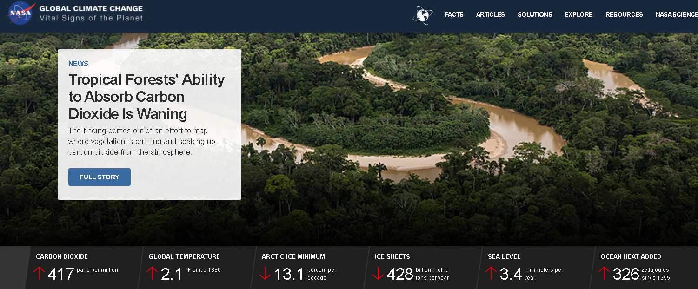
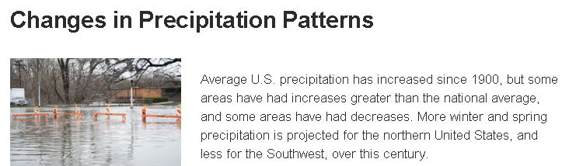
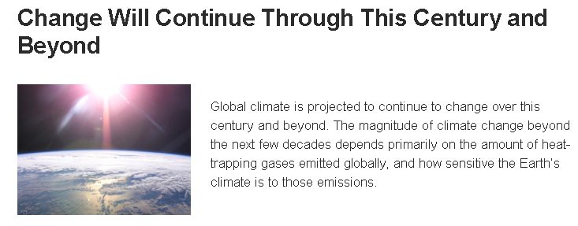
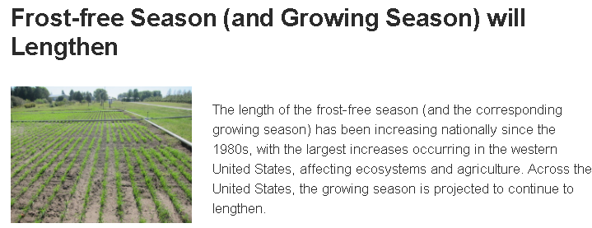
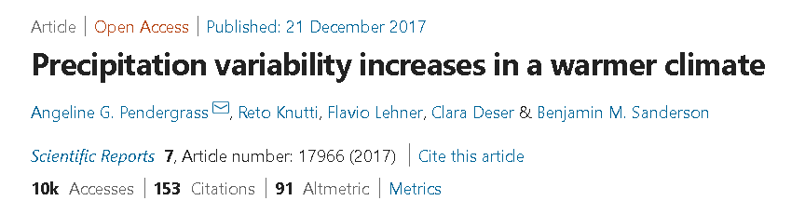
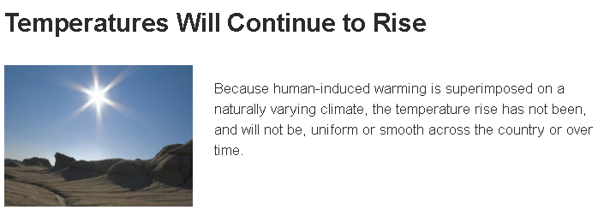
What is the orign? Human impacts?
climate.nasa.gov
climate.nasa.gov/effects

Slide 5
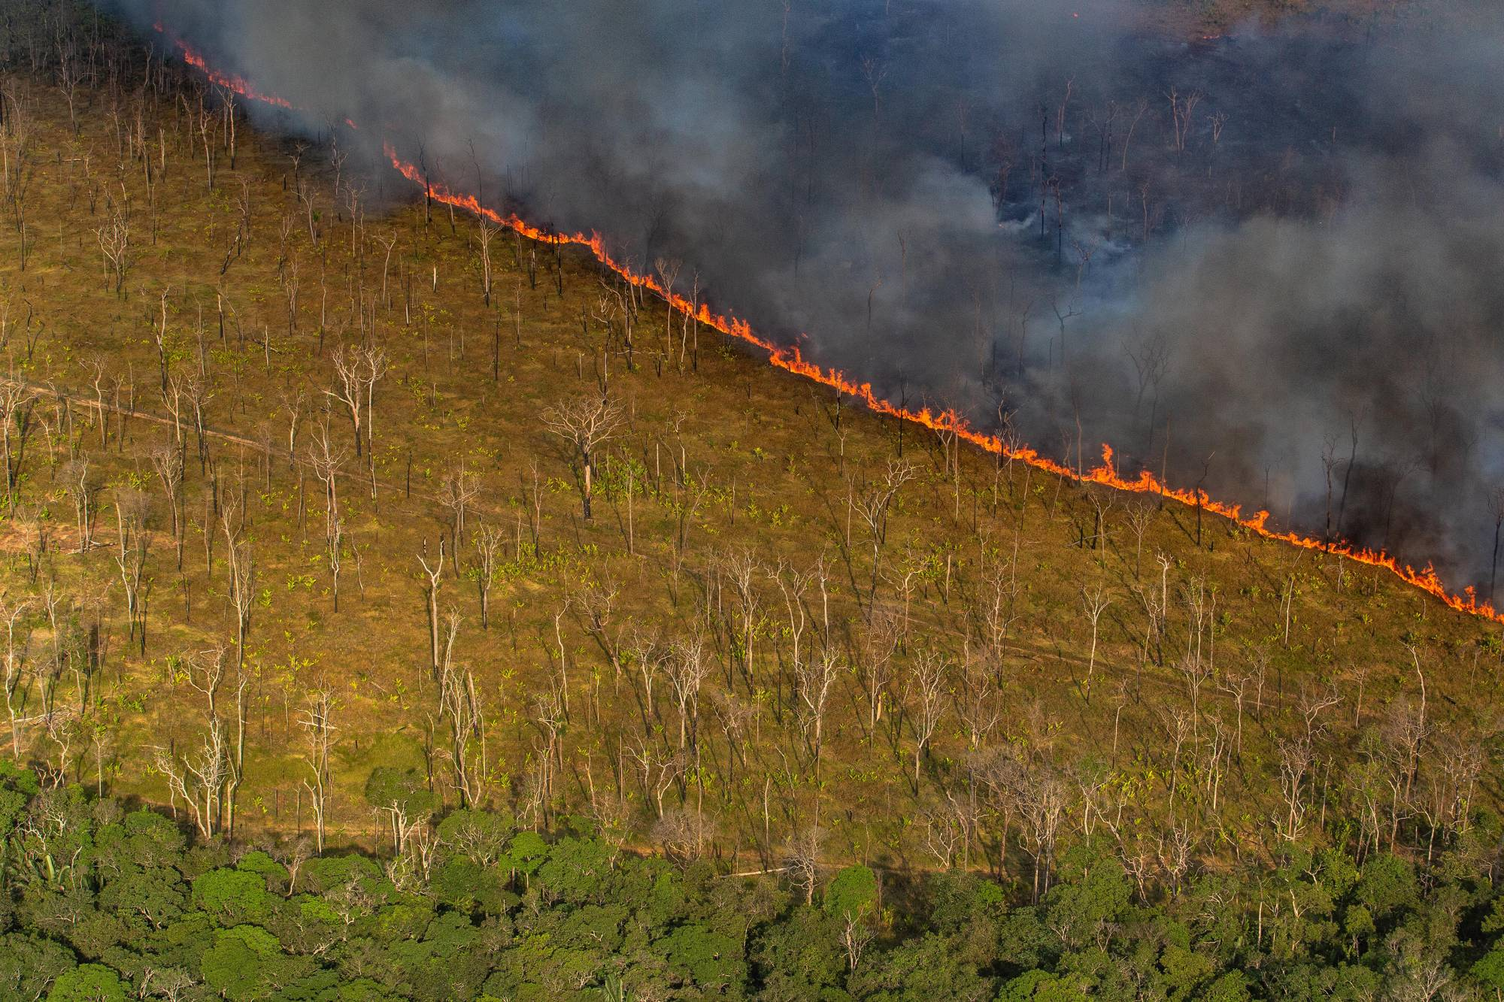
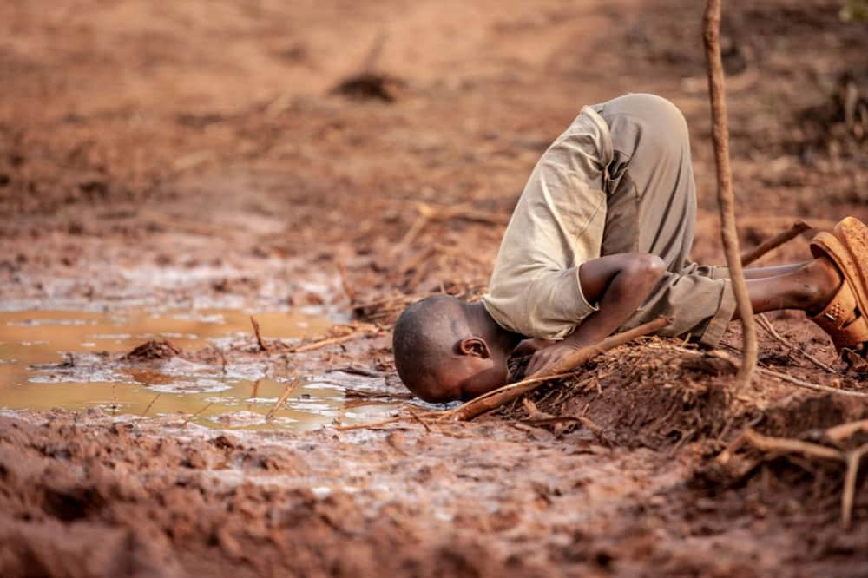
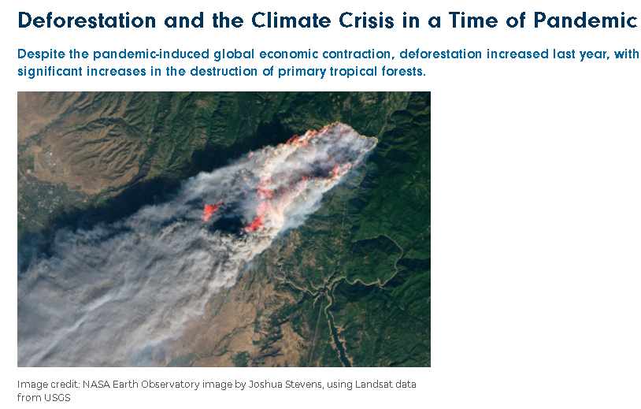
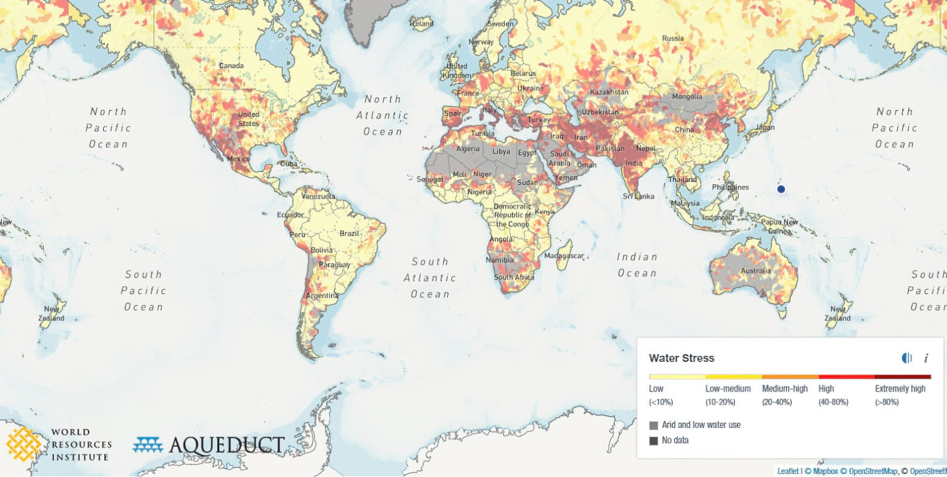
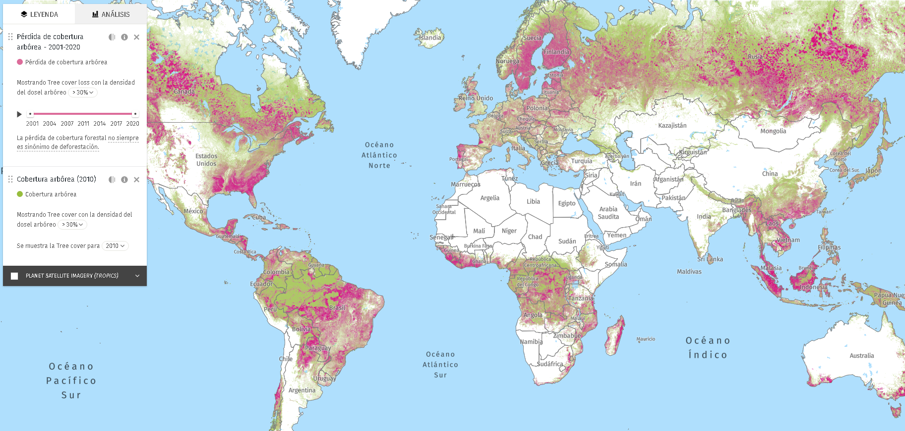
What is the problem?
URGENT!
Causes
IMPORTANT!
Water acces today
japantimes.co.jp
cc.gfamedia.org
wil.org
legal-planet.org
cc.gfamedia.org
globalforestwatch.org

Slide 6
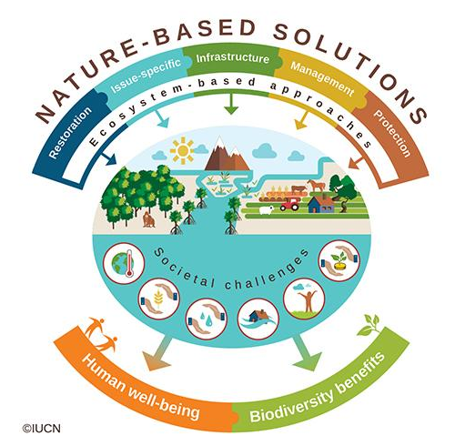
What is the problem?
URGENT!
Causes
IMPORTANT!
Water acces today
japantimes.co.jp
cc.gfamedia.org
Solution
Solution
wil.org
legal-planet.org
cc.gfamedia.org
globalforestwatch.org

Slide 7
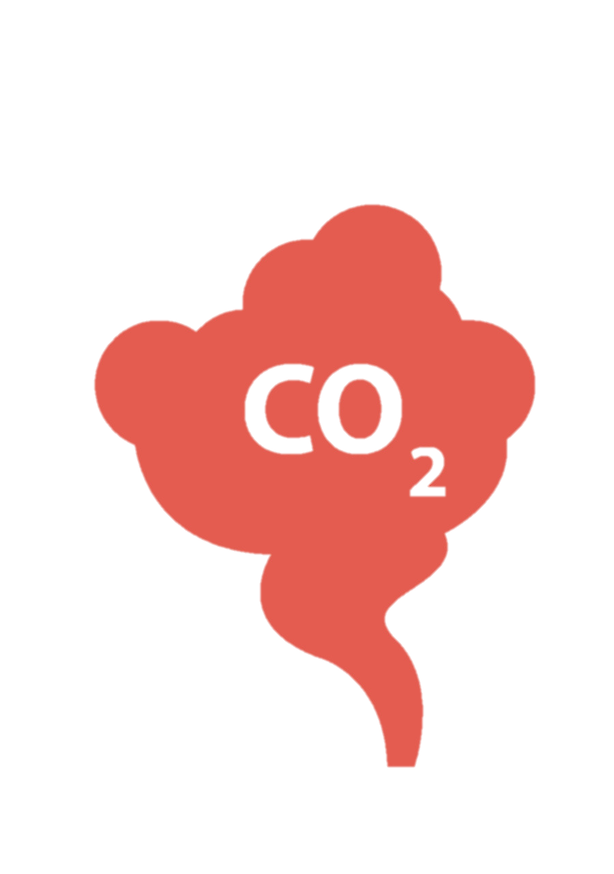








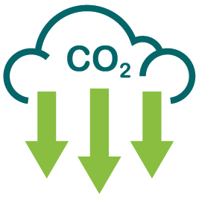




Nature Based Solutions (NBS)
-Wait, what (no investment)? Why?-
+
Clear
Trend:
Quality
Safe water
Drougths
Floods
-
+
Amount
Deforestation
Conservation
-
Sediments & pollutants
Beneficiaries:
Strategy: Avoid deforestation or restore forests
Execution: Single-time long- lasting effort
Costs: $0, or cheaper than delivery water bottles or build dams, drainages or channels

Slide 8




Goal
Provide a desktop/mobile platform for allow users to:
Find the closest river and basin geolocation in a map with one click in less than 5 seconds to solve urgent problem of water access
Estimate in less than 10 seconds the short-term historical trends of rainfall, temperature and forest cover to inform probability of water quality as inmediate problem
Identify historical deforestation inside a basin in about 15 seconds, and providing a map of current forest extent to inform decision makers where to conserve-restore and help mange the problem origin
Ayudar a usuarios (personas, empresas) a identificar la localización más cercana.
Soportar toma de decisiones de conservación y soluciones basadas en la naturaleza a través de datos históricos y espaciales

Slide 9



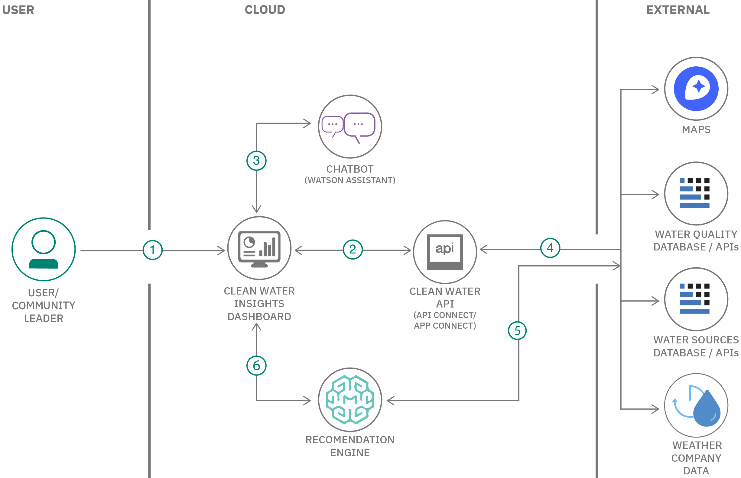

Architecture
IBM - Classic Vitual server
Ubuntu 20.04.2 LTS
+ NASA & other GIS sources
+ Watson assistant
+ Basins identification
+ Basemaps
+ Earth Engine - NASA API
+ R Plumber
+ Rivers extraction
+ Watson Studio
+ R Shiny
+ Deforestation maps
+ Tresholds and quantiles
+ R Core
+ Rainfall & temperatura maps

Slide 10
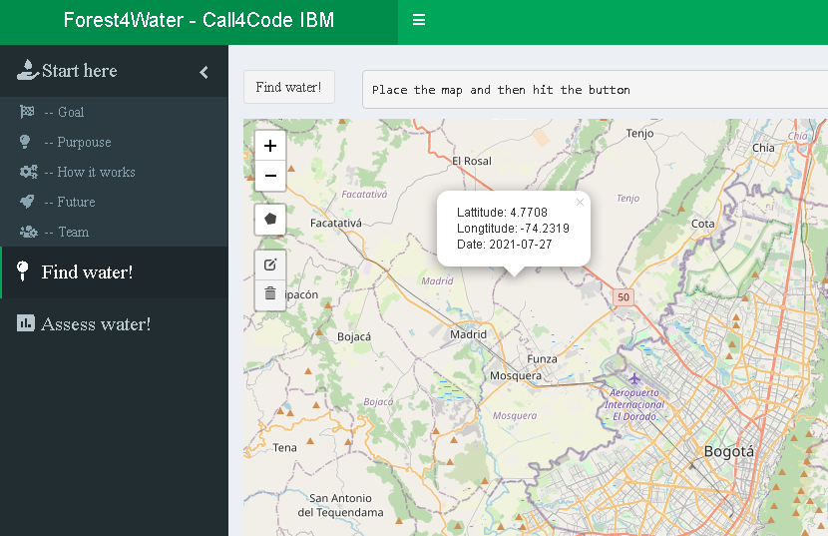
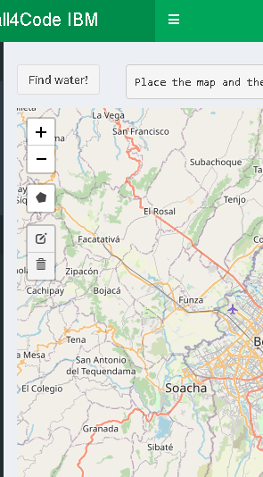
How it works?: 4 steps
0. Select a location arround the world (1 click)

Slide 11
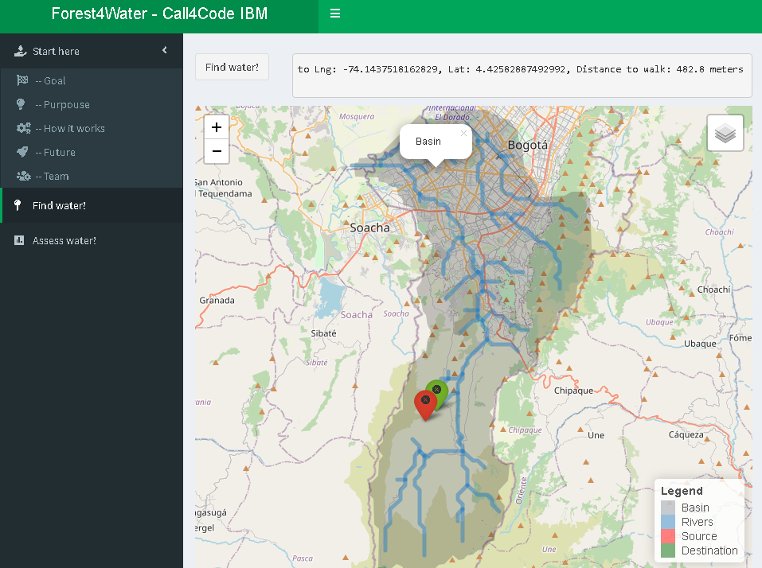
1. Get a basin and nearest river geolocation based in your coordinates: 1 click, 5 seconds

Slide 12
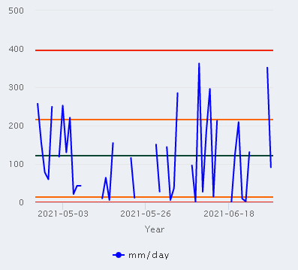
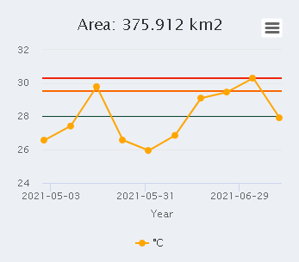
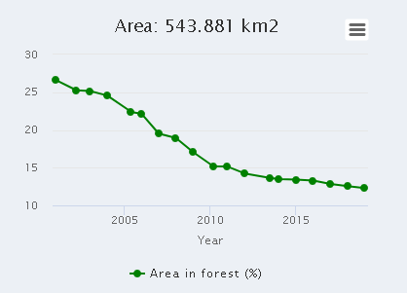
Lluvia (Corto plazo)
2. Get statistics, trends and water quality estimation based on recent history in your basin: 1 click, 10 seconds
Temperatura (Corto plazo)
Deforestación
(largo plazo)

Slide 13
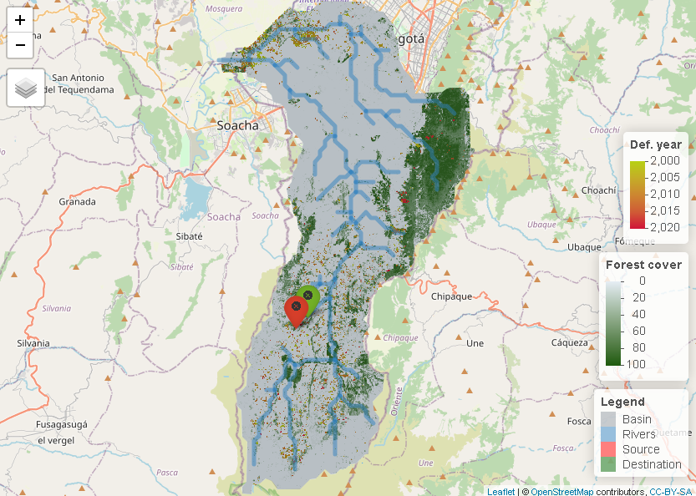
3. Get forest and deforestation maps to assess conservation and restoration activities in your basin: 1 click, 15 seconds

Slide 14
RoadMap
Analítica de información espacial responsiva
AI robusta
Prototipo con idea
Escalar la plataforma
Usar localización del usuario
Modularizar el sistema escalar en servicios IBM
1
3
5
1
3
5
2
4
6
Consumo de datos
100% Host en IBM
Nuevos datos
2
4
6
Usar nuevas fuentes de datos
Usar tecnologías robustas de inteligencia artificial
Generar dirección IP fija y usar otros idiomas

Slide 15






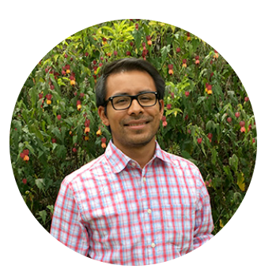




Gracias - Thanks - Obrigado
forest4water@gmail.com
Iván
González Ecologist
PhD Student – Ecoinformatics
Norther Arizona University (USA)
Ivan.Gonzalez@nau.edu
@gonzalezivan90
Fernando
Maldonado Computer systems eng.
Esp. Student – High performance distribuited processing
Veracruz technologic institute (Mex)
l15020799@veracruz.tecnm.mx
@ferjml97
Caleb Hernandez
Computer systems eng
Daniel
López Computer systems eng.
Msc. Student –Information eng.
Andes University (COL)
d.lopezl@uniandes.edu.co
@danflop

Slide 16
Some links
Climate change impact on flood and extreme precipitation increases with water availability | Scientific Reports (nature.com): https://www.nature.com/articles/s41598-020-70816-2
Summer of extremes: floods, heat and fire | World Meteorological Organization (wmo.int): https://public.wmo.int/en/media/news/summer-of-extremes-floods-heat-and-fire
Water Stress: A Global Problem That’s Getting Worse | Council on Foreign Relations (cfr.org): https://www.cfr.org/backgrounder/water-stress-global-problem-thats-getting-worse
Climate Change Indicators in the United States | US EPA: https://www.epa.gov/climate-indicators
Water Stress: The Unspoken Global Crisis - Gospel for Asia (gfa.org):
https://www.gfa.org/special-report/dying-of-thirst-global-water-crisis/
Most Important Conversation for Nature - WILD Foundation
Most Important Conversation for Nature - WILD Foundation

